Slide 1



North Carolina Balance of State
Continuum of Care
FY 2025 CoC Program Competition Office Hours
Nov 20, 2025
10:00 AM

Slide 2

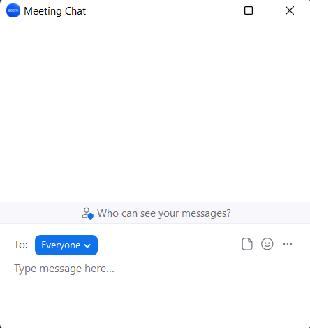
Welcome to Office Hours
  Today we will cover
  recent updates to the FY 2025 CoC
  Program Competition.
  After these updates, we will also hold
  a Q&A session. To ask questions during
  the session, please use the chat or raise
  your hand on Zoom.
  The chat box is available to use
  anytime.
Notes:
Everyone’s line was set on mute when you signed on this morning. We do encourage your questions by using the chat box. And hopefully you can unmute yourselves to ask questions when we pause to address questions.
We will monitor the chat box and make sure we respond to your questions.

Slide 3

Introductions
In the chat, please share the following:
Name
Organization/Region
Role within the CoC
Check-in question: What emoji best describes your outlook today?

Slide 4

Agenda
Historical Update on CoC Competition
Timeline of Events for the Competition
Funding Priority Changes
Debrief and Q&A Session
Notes:
We’ll share our current understanding of the new CoC program competition priorities and focus areas and how we will be preparing internally.
We’ll then have debrief discussion and allow space for questions. Let’s support each other an forge a path forward together.

Slide 5
FY 2025 CoC Program Competition
Update
Notes:
10 min

Slide 6
Recent Historical Updates
In 2024, HUD released its first-ever 2-year Notice of Funding Opportunity (NOFO) for the Continuum of Care (CoC) Program.
The FY 2024 CoC Competition followed protocols and processes familiar to communities nationwide.
The upcoming FY 2025 CoC Competition would have represented the second phase of this 2-year NOFO cycle.
On July 3, 2025, HUD emailed updated guidance to CoCs that reflects new federal administration priorities.
A corresponding Congressional funding bill was passed on July 4, 2025, formally solidifying HUD’s new strategic direction into law.
Congress was in recess until Sept. 2, 2025.
The federal gov’t shut down for several weeks, reopening Nov. 12, 2025.

Slide 7
FY 2025 CoC NOFO Important Dates
Date | Event
Nov 12, 2025 | Federal government reopens after 43-day shutdown
Nov 13, 2025 | HUD releases the FY2025 CoC NOFO on Grants.gov
Nov 13, 2025 | Application window opens
Jan 14, 2026 | Application deadline (8:00 PM EST)
Jan–Feb 2026 | HUD reviews applications and scores projects
Spring 2026 | Funding announcements expected
Notes:
https://www.grants.gov/search-results-detail/360861

Slide 8
FY 2025 CoC Competition Funding Priorities
Transitional housing and supportive services are now central to the application. HUD explicitly capped permanent housing at 30% of Annual Renewal Demand (ARD).
This means that CoCs will have to reallocate toward transitional housing, treatment, and employment-focused programs.
Street outreach and treatment/recovery services are emphasized as key strategies for addressing root causes of homelessness, especially substance use and mental health.
Employment-focused interventions are encouraged to promote long-term self-sufficiency.

Slide 9
FY 2025 CoC Competition Funding Priorities
Faith-based partnerships are actively promoted in the NOFO. HUD leadership now encourages collaboration with faith-based providers.
No new permanent housing projects are allowed under this NOFO, except for renewals. New Joint TH–RRH projects are also excluded.
Housing First is deprioritized compared to years past. HUD favors transitional housing models that emphasize behavioral health and self-sufficiency/independence.

Slide 10
Major Change – Tier 1 vs. Tier 2 Funding Caps
Tier 1 vs. Tier 2:
  Tier 1: The safer funding tier. Projects placed here are most likely to be funded.
  Tier 2: The competitive tier. Projects here must score well to win funds, and some may not be funded.
This year’s shift: Only 30% of your total renewal funding can sit in Tier 1; the other 70% must go in Tier 2 and compete.

Slide 11
Major Change – Permanent Housing Cap
Permanent housing cap (spell out acronyms):
No more than 30% of funding can go to:
  PSH: Permanent Supportive Housing
  RRH: Rapid Re‑Housing
  Joint TH–RRH: Joint Transitional Housing – Rapid Re‑Housing
This pushes communities to invest more in outreach, transitional housing, and services.
For reference, NC BoS CoC’s current permanent housing budget is $21,243,262, including SNOFO funds eligible for renewal in this competition. Our funding cap would be $7,141,742.

Slide 12
Major Change – All Projects Compete & DV Bonus
Competition required (exceptions listed below):
Almost all projects must compete for funding.
Main exceptions: CoC Planning (Continuum of Care planning funds) and UFA costs (Unified Funding Agency administrative costs).
Domestic Violence (DV) Bonus:
$52 million is set aside for new Domestic Violence projects, including transitional housing.

Slide 13
Major Change – New Project Types
This NOFO introduces two new project types eligible for CoC funding: Transitional Housing (TH) and Supportive Services Only (SSO). CoC Program Components
SSO projects are different than the typical SSO-Coordinated Entry project
New SSO projects can be one of two variants: SSO-Standalone or SSO-Street Outreach
The following lists are subject to change, depending on which project types our Funding & Performance Subcommittee determine to be in line with our FY2025 Funding Priorities (TBD November 20)
CoC Bonus – Projects Serving General Population
Supportive Services Only (Standalone or Street Outreach)
Transitional Housing
Rapid Rehousing
Permanent Supportive Housing
SSO-Coordinated Entry
HMIS (Reserved for HMIS lead)
DV Bonus – Projects Serving IPV Survivors
Transitional Housing
Rapid Rehousing
SSO-Coordinated Entry

Slide 14
Note– New Project Criteria
All new projects must meet the project eligibility and project quality threshold requirements established by HUD in sections V.A.4.a and V.A.4.b of the FY2025 NOFO. HUD has developed threshold criteria where if a New Project application does not meet 4 out of 6 points, for example (varies by project type), it will be rejected by HUD.
These criteria will be incorporated into NC BoS CoC’s New Project Scorecard.
New project criteria includes (see NOFO for full list):
Required: The project applicant will not engage in racial preferences or other forms of illegal discrimination.
Required: The project applicant will not operate drug injection sites or “safe consumption sites,” knowingly distribute drug paraphernalia on or off of property under their control, permit the use or distribution of illicit drugs on property under their control, or conduct any of these activities under the pretext of “harm reduction.”
The project will be supplemented with resources from other public or private sources, that may include mainstream health, social, and employment programs such as Medicare, Medicaid, SSI, and SNAP.
The proposed project will require program participants to take part in supportive services (e.g. case management, employment training, substance use treatment, etc)
TH: Demonstrate that the proposed project will provide 40 hours per week of customized services for each participant (e.g. case management, employment training, substance use treatment, etc.). The 40 hours per week may be reduced proportionately for participants who are employed.
PSH: The project will be designed to serve elderly individuals and/or individuals with a physical disability/impairment or a developmental disability (24 CFR 582.5) not including substance use disorder. The units will prioritize these populations.
RRH: The applicant has previously operated homelessness projects where outcomes for employment income were improved compared to the average project in the CoC.

Slide 15
Note– Renewal Project Criteria
CoCs must consider the need to continue funding for Renewal Projects. Renewal Projects must meet the minimum project eligibility, capacity, timeliness, and performance standards identified in this NOFO or they will be rejected by HUD from consideration for funding.
These criteria will be incorporated into NC BoS CoC’s Renewal Project Scorecard.
When considering renewal projects for award, HUD will review information in eLOCCS, APRs, and information provided from the local HUD CPD field office, including monitoring reports and audit reports as applicable, and performance standards on prior grants, and will assess projects using the following criteria on a pass/fail basis (full list on NOFO):
Whether the project applicant’s performance met the plans and goals established in the initial application, or grant as amended;
Whether the project applicant demonstrated all timeliness standards for grants being renewed have been met, including those standards for the expenditure of grant funds;
The project applicant’s performance in assisting program participants to achieve and maintain self-sufficiency and independent living and records of success, except dedicated HMIS projects are not required to meet this standard; and
Evidence of unwillingness of project applicants to accept technical assistance, a history of inadequate financial accounting practices, indications of project mismanagement, a drastic reduction in the population served, program changes have been made without prior HUD approval, or the loss of project site control.

Slide 16
Note– Renewal Project Criteria
HUD reserves the right to reduce or reject a project application submitted during the CoC Program Competition for the following reasons:
outstanding obligation to HUD that is in arrears or for which a payment schedule has not been agreed upon;
audit finding(s) for which a response is overdue or unsatisfactory;
history of inadequate financial management accounting practices;
evidence of untimely expenditures on prior award;
history of other major capacity issues that have significantly affected the operation of the project and its performance;
history of not reimbursing subrecipients for eligible costs in a timely manner, or at least quarterly; and
history of serving ineligible program participants, expending funds on ineligible costs, or failing to expend funds within statutorily established timeframes.
evidence that the project has previously or currently conducts activities that subsidize or facilitate racial preferences or other forms of illegal discrimination or conduct activities that rely on or otherwise use a definition of sex other than as binary in humans.
evidence that the project operates drug injection sites or “safe consumption sites,” knowingly distributes drug paraphernalia on or off of property under their control, permits the use or distribution of illicit drugs on property under their control, or conducts any of these activities under the pretext of “harm reduction.”

Slide 17
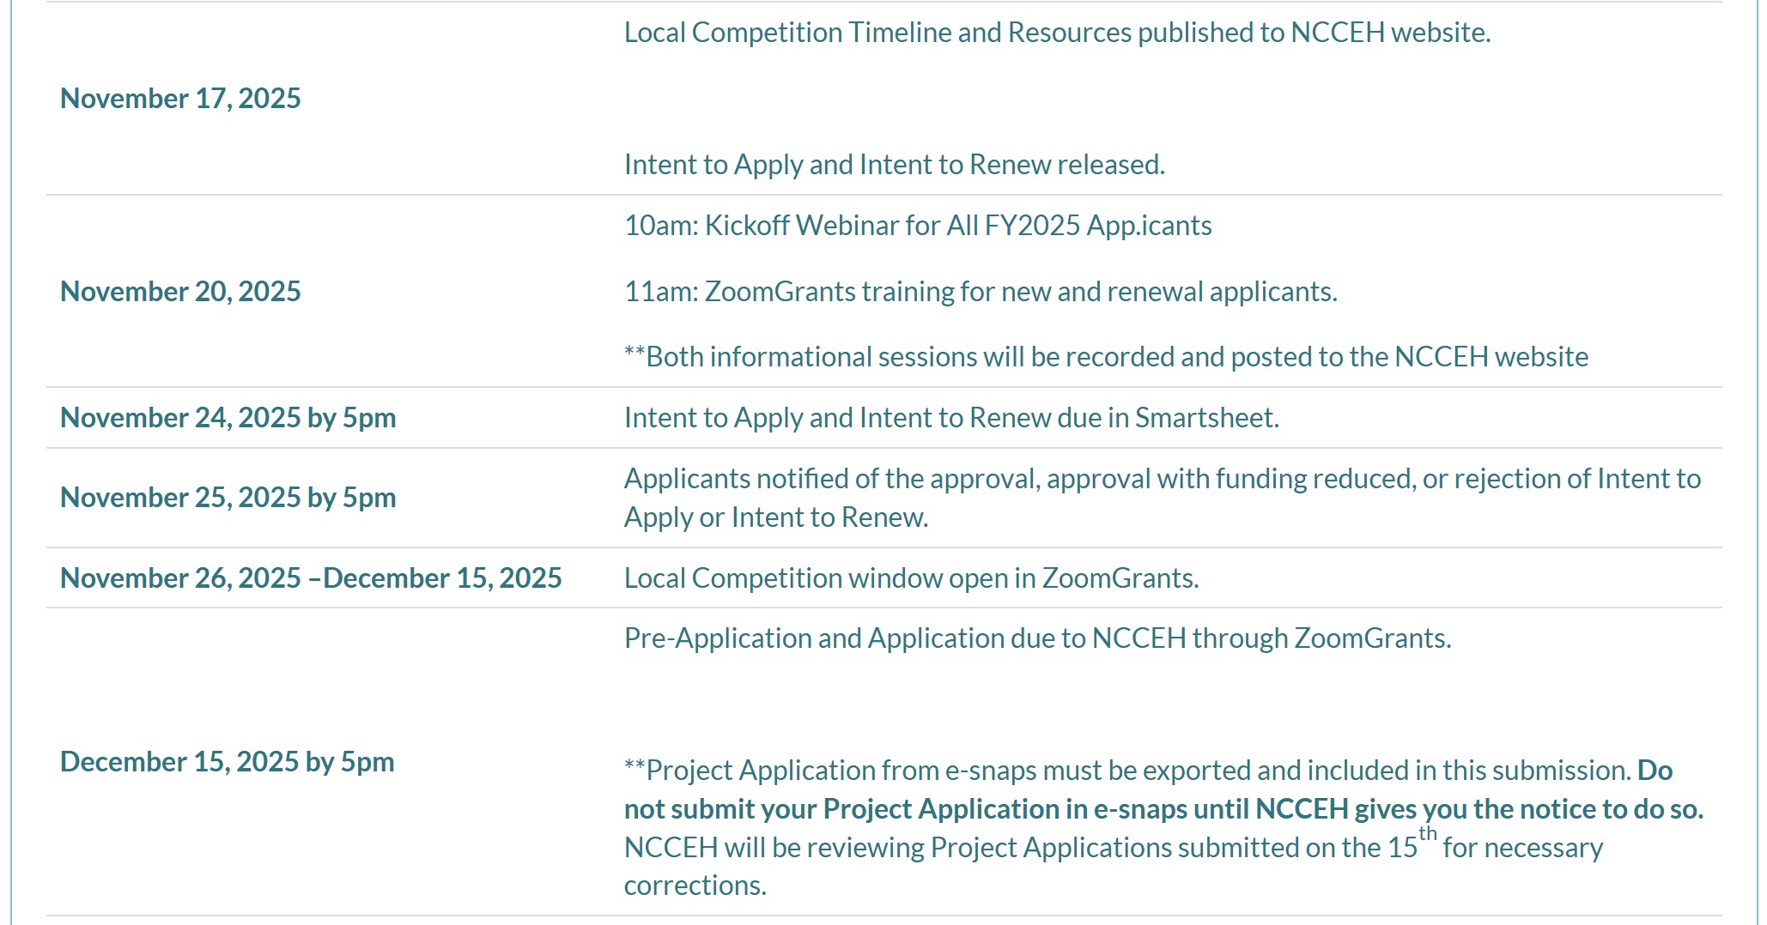
NC BoS CoC: Local Competition Timeline
Timeline and additional resources posted on https://ncceh.org/funding-opportunities/

Slide 18
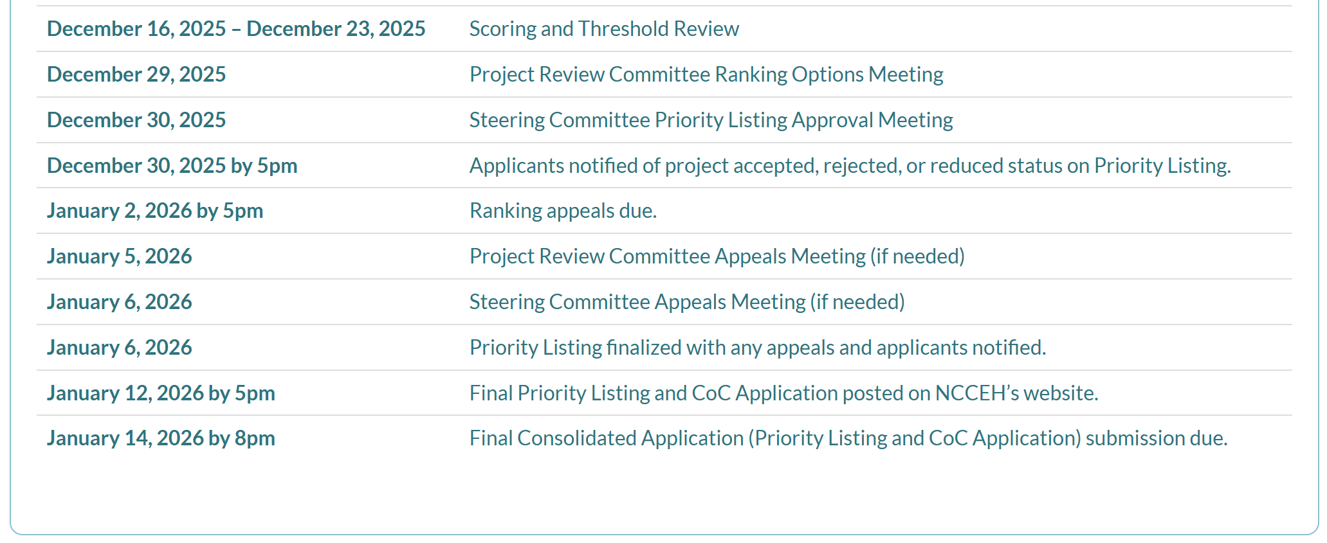
NC BoS CoC: Local Competition Timeline

Slide 19

Q&A
Notes:
Ask for questions from the audience

Slide 20

Take Home Message
Align narratives to the NOFO: emphasize transitional housing, outreach, services, and employment where relevant.
Review scoring criteria: focus on sections that most affect Tier 2 competitiveness.
Plan for the DV Bonus: consider eligible projects and strong survivor‑centered narratives.
Share drafts with partners: get community and program staff review before final submission.
NCCEH will communicate deadlines early: build time for edits, leadership sign‑off, and a final quality check. This is a sprint!

Slide 21
Next Steps
Immediate Actions
Today at 11am: Introduction to ZoomGrants Training
To be finalized this week/early next week and posted on NCCEH website once approved by Steering Committee
  Updating Written Standards, Anti-Discrimination Policy, and Client Bill of Rights to adhere to HUD guidelines
  Funding & Performance Subcommittee meeting at 2pm today to update FY2025 Funding Priorities
  Scorecard Committee meeting at 2:30pm tomorrow to update New and Renewal Project Scorecards
Intents to Apply and Intents to Renew are due no later than Monday, November 24 at 5pm
Notes:
Last 5 mins of call

Slide 22
Next Steps
Short Term Actions (next 2–3 weeks)
NCCEH will continue to update the website as quickly as possible with resources for our applicants
Applicants who submitted an Intent to Apply or Intent to Renew and are approved to apply will begin working in e-snaps on their official project application
Applicants will also be invited to ZoomGrants. Applicants will export their e-snaps project application to upload into ZoomGrants, along with other supplementary documents for the local competition
Notes:
Last 5 mins of call

Slide 23
Dates of Upcoming Office Hours
- X date
- Y date
Please reach out with any questions to:
bos@ncceh.org
  919.755.4393
Notes:
Unhide slide if more Office Hours will be offered

