Slide 1
Unsheltered Access Coordinator Planning & Training
June 10, 2025
Notes:
Elliot

Slide 2
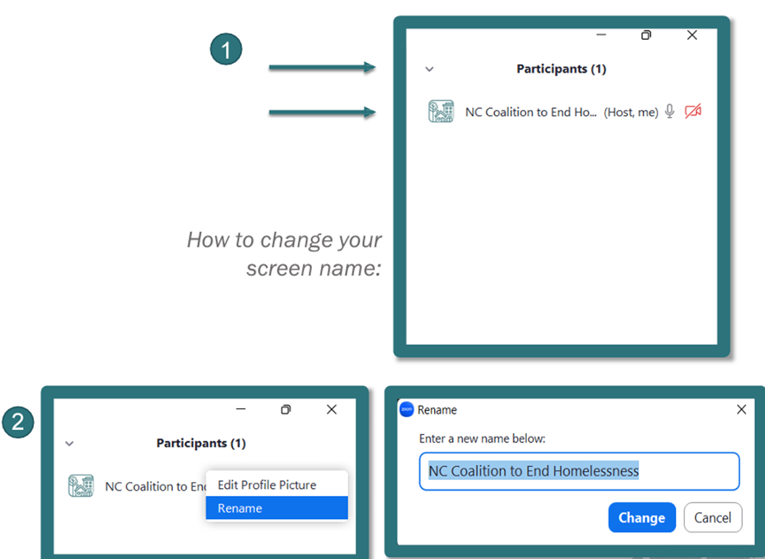
Roll Call
We will conduct Roll Call for Regional UACs.
All participants should enter their full names, so we can document their participation in the minutes.
Notes:
Elliot

Slide 3
Agenda
Notes:
Elliot

Slide 4
Agenda
Introductions
Roles and Responsibilities
UAC Planning & Training Webinar Overview
PIT Count
Asynchronous Orientation Idea
Discussion
Next Steps and Reminders
Notes:
Elliot

Slide 5
Introductions
Notes:
Elliot

Slide 6
Introductions
Please introduce yourself and share the following:
Name and pronouns
Agency and/or role in the community
Notes:
Elliot
In the chat or go-round? How much time?
Brittany W – Reg 8
David – Reg 12
River uses they/them
Michelle Wood works with DC Connect (county level program that works with re-entry folks, homeless folks, and

Slide 7
Roles and Responsibilities
Notes:
Andrea & Elliot

Slide 8
Unsheltered Homelessness
Unsheltered Homelessness is defined by HUD:​
"Place not meant for habitation (e.g., a vehicle, an abandoned building, bus/train/subway station/airport or anywhere outside)​”
This is one way to be in HUD’s “Category 1: Literally Homeless”, which is part of the definition of homelessness for program and service eligibility.
Notes:
Andrea

Slide 9
Unsheltered Access Coordination Framework
Work to identify, connect, and house people experiencing unsheltered homelessness is a year-round effort!​
Regional Committees need to work collaboratively to meet their goals – no single person or agency can do this work alone.​
UAC should include a mix of assertive & passive outreach at regular intervals​
Identified people should be assessed & referred to the CE system by-name list.​
Someone should be assigned to regularly check-in with each person identified & help them navigate to the services they need.​
Notes:
Andrea
Ask the group about assertive and passive outreach

Slide 10
Year Round Connection
Unsheltered Access is a year-round process.
All year, you are responsible for connecting people experiencing unsheltered homelessness to Coordinated Entry.
Once a year (the last week of January), we report homelessness to HUD through the “Point in Time” count.
Year-round unsheltered access coordination builds relationships to connect people to housing AND to know where people are so they’re counted in PIT.
The goal is to end unsheltered homelessness (not just counting once a year)
Notes:
Andrea

Slide 11
Elected Unsheltered Access Coordinators play an essential facilitation role in the region.
Unsheltered Access Coordinators (UACs) facilitate the regional plan to identify & connect people experiencing unsheltered homelessness to services & housing.
Serves as regional point person for the CoC & providers
Coordinates with the regional CE Lead
Ensures data collection happens on all people experiencing unsheltered homelessness
Engages all providers/organizations/stakeholders to understand & implement the process
Provides training & technical assistance as needed to stakeholders
Reports progress regularly at Regional Committee & monthly CoC UAC meetings
Notes:
Elliot

Slide 12
CE Leads are a key partner in regions to support planning & implementation.
Regional CE Leads work closely with UACs to implement the local plan to collect data & connect people experiencing unsheltered homelessness to permanent housing.
Partners with UACs to help support planning, training, & implementation as needed
Helps with data entry
Engages partners to participate in Unsheltered Access Coordination activities
Provides ongoing updates to UACs & regional stakeholders regarding data on people experiencing unsheltered homelessness populating the CE by-name list
Plays a significant role in collecting & updating data during the annual unsheltered PIT count
Notes:
Elliot

Slide 13
Community stakeholders serve an important role implementing regional UAC plans.
Community partners, including service providers, regional leadership, & volunteers, are crucial to implementing the regional UAC plan.
Provide input & feedback in ongoing planning & implementation activities
Participate in assertive & passive outreach activities to identify & connect people experiencing unsheltered homelessness to services & housing
Conduct CE assessments, collect data, & enter data into HMIS
Provide ongoing services to people experiencing unsheltered homelessness & serve as advocates during CE case conferencing
Notes:
Elliot
Ask group about community stakeholder relationships?

Slide 14
PIT Count
Notes:
Andrea
Role of UAC, here’s something you did last year!

Slide 15
What is PIT Count?
Point-In Time and Housing Inventory Count
Last week in January
Unsheltered count conducted by street outreach teams (including volunteers)
UAC recruits, trains and coordinates teams and volunteers
UAC facilitates data submission, data quality and completeness
Notes:
Andrea

Slide 16
What does one day tell us?
*Unsheltered data was not collected in 2021 due to the pandemic
Notes:
3185 in 2020, 996 Unsheltered, 324 CH 1520 in 2021, Unsheltered not counted, 135 CH
2491 in 2022, 776 Unsheltered, 267 CH 3311 in 2023, 1314 Unsheltered, 253 CH
4810 in 2024, 2127 Unsheltered, 572 CH
Right now – there are 1405 people in 1011 households identified as unsheltered in the last three months. To put it another way,

Slide 17
What does one day tell us?
Region | 2024 Unsheltered | 2025 Unsheltered
1 | 194 | 153
2 | 186 | 193
3 | 218 | 203
4 | 202 | 191
5 | 288 | 427
6 | 48 | 49
7 | 475 | 666
8 | 95 | 47
9 | 195 | 20
10 | 58 | 47
11 | 53 | 58
12 | 48 | 63
13 | 135 | 108
(releasing next week)
Notes:
More people in more places, we were able to identify folks experiencing unsheltered homelessness in 60 of our 79 counties
Better data completeness! (because we engaged clients year round with community partners, less than 5% of clients were missing age.
19 of our 79 counties reported 0 clients experiencing unsheltered homelessness, so we know this is still an under count!
60 Counties reported out! Did not:
Bertie Chowan Columbus Dare Duplin Edgecombe Gates Granville Greene Halifax Lenoir Madison Nash Northampton Pamlico Person Polk Rockingham Scotland

Slide 18
What does one day tell us?
People experiencing unsheltered homelessness should be identified and connected to services year-round!
On January 29th, we counted 2,225 unsheltered people
Between March and May, our By Name List identified 1,405 people as unsheltered
Year-round, we estimate that we identify 40-60% of those unsheltered through Coordinated Entry
Notes:
so how do we make everyday PIT day and expand identification and access to Coordinated Entry year-round?

Slide 19
UAC Planning & Training Webinars
Notes:
Elliot –

Slide 20
UAC Planning & Training Webinar
Monthly UAC webinars will include:
Planning materials from NCCEH staff
Training materials from NCCEH staff
Notes:
Elliot

Slide 21
UAC Planning & Training Webinar
Monthly UAC webinars will include:
Training and support from NCCEH staff
Progress reports from regional UACs
Peer to peer learning opportunities between regional UACs
UACs can share challenges in their region
UACs can use their shared knowledge to help determine solutions
Notes:
Elliot

Slide 22
UAC Planning & Training Webinar
Example:
Please provide an update on any regional meetings you attended this month.
How will your region address outreach in counties where the region traditionally has had trouble providing coverage?
Are there any challenges you’d like to troubleshoot with the group?
What support do you need from NCCEH?
Notes:
Elliot

Slide 23
Resource
NCCEH has a new website – would it be helpful for UAC materials (slide deck, webinar recordings, forms) to be on a specific page of our website?
What do you wish you knew as a new UAC?
Notes:
Elliot – possibly LMS training

Slide 24
Discussion

Slide 25
Discussion
What does implementing the UAC role look like for you?

Slide 26
Questions
Questions for your peers?
Questions for NCCEH staff?
Question for YOU
Does the first Tuesday at 1 PM work well or is there another day that works better?

Slide 27
Reminders

Slide 28
Reminders
July 8th at 1 pm is our next meeting!

