Slide 1
North Carolina Balance of State
Continuum of Care
Steering Committee Meeting
April 1, 2025
10:30 AM

Slide 2
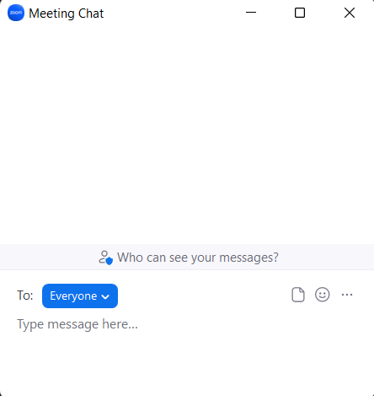
Welcome
Reminders:
Your line is muted.
We will unmute the line during Q&A pauses.
The chat box is available to use anytime.

Slide 3
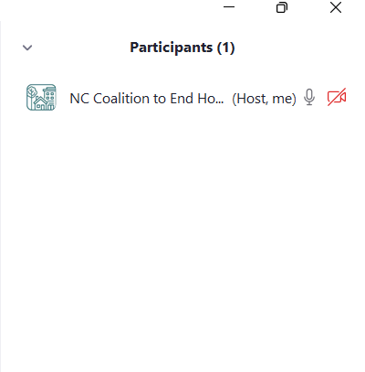
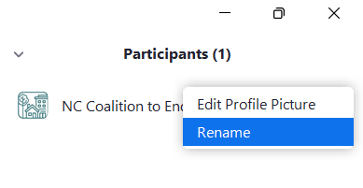
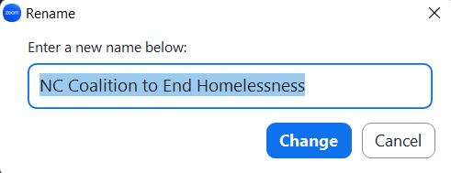
Roll Call
1
We will conduct Roll Call for Regional Leads and at- large members to confirm quorum for voting.
How to change your screen name:
All participants should enter their full names, so we can document their participation in the minutes.
2

Slide 4
Agenda

Slide 5
Agenda
Consent Agenda
BoS CoC Updates
NCCEH Staffing Updates
Recent Federal Interventions
Veteran Data Report
Coordinated Entry from FY2022 SSO-CE Grant
FY2025 CoC Competition Updates
HMIS Advisory Board Update
Upcoming Meetings & Reminders

Slide 6
Review & approve consent agenda
Consent agenda: https://www.ncceh.org/bos/steeringcommittee/
The consent agenda was sent to the Steering Committee prior to the meeting as a part of the Board Packet.
The consent agenda will be voted on as a whole at the beginning of each meeting.
Steering Committee members may request to remove an item from the consent agenda for additional discussion.
Changes or discussion?

Slide 7
BoS CoC Updates

Slide 8
FY2024 CoC Program Grant Agreements
Some agencies with FY2024 CoC Program grants for PSH with renewal start dates between January and April were sent grant agreements starting on March 13th. These grant agreements included new information that Continuum of Care funds cannot be used:
To promote “gender ideology”
To promote “elective abortions”
To “promote diversity, equity, and inclusion that violate any applicable Federal anti-discrimination laws”
Language changes also included:
following applicable immigration restrictions and requirements, including local government grantees not promoting illegal immigration or providing sanctuary policies; as well as, using a verification system approved by the Federal government to prevent serving an “ineligible alien who entered the United States illegally or is otherwise unlawfully present in the United States.”
Not enforcing Housing First
Not discriminating against an organization based on the organization’s religious character, affiliation, or exercise
These grant agreements were rescinded late in the day on March 14th due to a court order.

Slide 9
FY2024 CoC Program Grant Agreements
Late on March 20th, at least 1 agency in the NC BoS CoC was issued a revised FY2024 CoC Program grant agreement for Permanent Supportive Housing effective April 1, 2025.
The revision in the updated grant agreement got rid of the struck through words below:
certifies that it does not operate any programs promoting diversity, equity, and inclusion that violate any applicable Federal anti-discrimination laws, including Title VI of the Civil Rights Act of 1964.

Slide 10
FY2024 CoC Program Grant Agreements
NCCEH response:
In our recent conversations with HUD staff in the Greensboro FO, NCCEH was advised to understand the shifting nature of the federal funding landscape and to be aware that HUD is paying attention to organizations that are not aligned with the new Administration's priorities. Therefore, NCCEH encourages partners to (1) review renewal grant agreements carefully to identify language that constricts your ability to continue programs because of your emphasis on diversity, equity, and inclusion; gender identity and inclusion; and/or bodily autonomy, (2) maintain close communication with your HUD FO, and (3) work with NCCEH to help elevate your concerns and advocate with you.

Slide 11
NCCEH Staffing Updates

Slide 12
NCCEH Staffing Updates
The last several weeks have brought some changes to NCCEH; however, the agency remains focused on the critical work that we do alongside our partners in the NC BoS CoC and across the state. Our FY2023 Planning Grant has been executed and allows to remain fully staffed. We currently have the following positions available:
Project Specialist (SOAR) -- Interviews begin this week!
NC BoS CoC Project Director – Job Post coming soon!
Project Specialist (D1FF Diversion Program, EHVs, and Regional Liaison)

Slide 13
Veteran Data Report

Slide 14
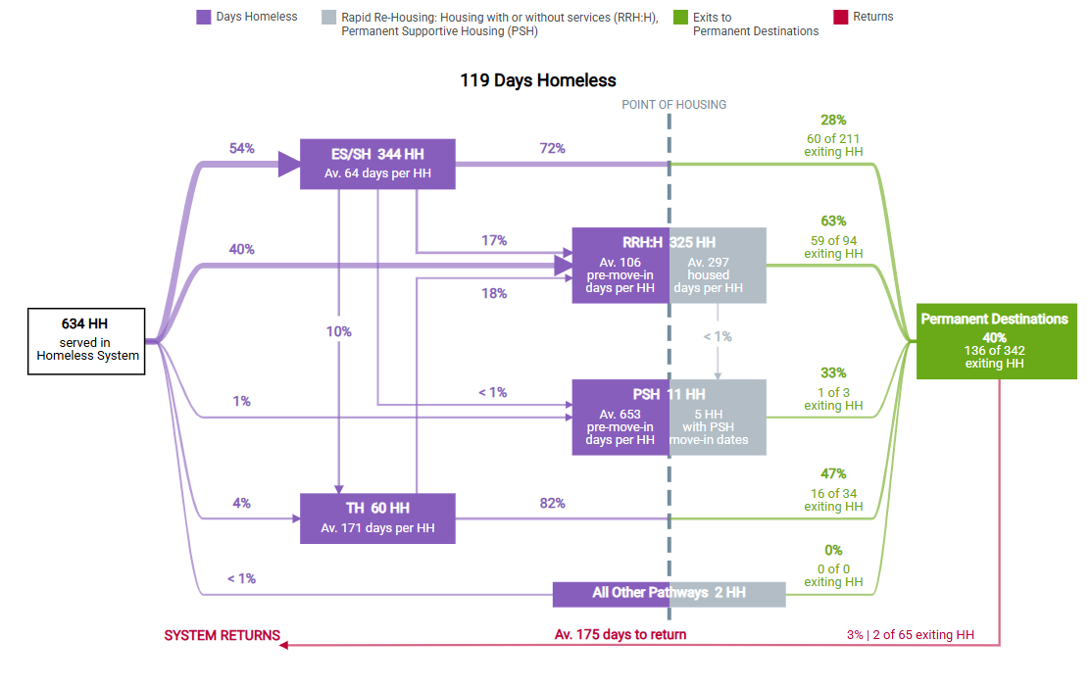
10/1/2023 – 9/30/2024
Notes:
The NC BoS CoC Veteran Subcommittee tracks various data points to better understand trends among Veteran homelessness. This is a Stella P visual of ALL AO Veteran households served in the NC BoS CoC HMIS system (ES, TH, RRH, and PSH) during FY 2023. Therefore, CE and SO projects are not reflected. Additionally, most HUD VASH (PSH for Veterans) is not reflected either.

Slide 15
Data Element: Length of Time Homeless
Goal: Decrease average days Veterans experience homelessness to 115 days by 2025.
FY2023 HMIS Data: Veterans enrolled in ES, TH, RRH, & PSH projects spent an average of 123 days homeless
FY2024: 119 days
Notes:
By using the Stella P visualization, we can compare data to previous years. Here, we see that average days homeless for Veterans in FY22 was 123 days, and in FY23 it was 119. Average days homeless are trending in the right direction toward the goal of 115 days in FY25.

Slide 16
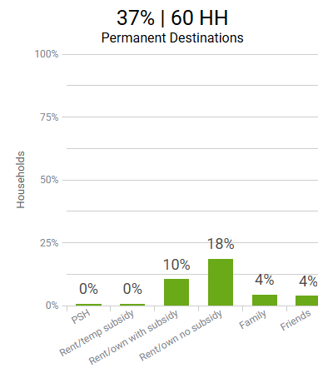
Data Element: Race/Ethnicity demographics & outcomes
Goal: Increase permanent housing placements for Black/African American Veterans to 50% by 2025.
FY2023 HMIS Data: 51% of Veterans served in ES, TH, RRH, & PSH projects were Black/African American; 39% permanently housed were Black/African American.
FY2024: 52% served identified as Black/African American; 37% permanently housed.
Notes:
Here, we can see in FY22 51% of Veterans were Black/African American and 39% permanently housed were Black/African American. In FY23 52% identified as Black/African American, and of those permanently housed 37% were Black/African American. Black/African Americans are overrepresented in our homeless response system, with around 23% of all Veterans in NC identifying as Black/African American and around 50% of Veterans experiencing homelessness identify as Black/African American. Within the rehousing system, they are underrepresented – we would expect around 50% of those exiting to permanent housing being Black/African American. Our system has a ways to go to ensure an equitable rehousing system for Black/African American Veterans.

Slide 17
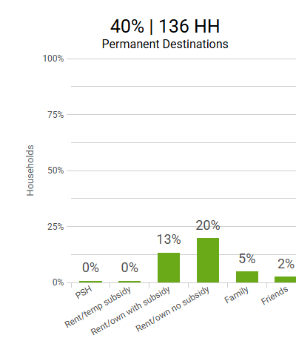
Data Element: Exits to Permanent Housing
Goal: Increase permanent housing placements for Veterans to 50% by 2025.
FY2023 HMIS Data: percentage of Veterans served in ES, TH, RRH, & PSH projects permanently housed was 41%.
FY2024: 40% were permanently housed
Notes:
Permanent housing placements for Veterans, overall, are holding steady at around 40%. The goal is to increase this to 50% by FY2025.

Slide 18
Coordinated Entry
FY22 SSO-CE Grant

Slide 19
NCCEH receives a CoC grant to support CE.
Operating year: December 1, 2023 – November 30, 2024
NCCEH sub-granted funds to the following agencies:
Region | Agency
1 | HERE in Jackson Co
2 | Thrive
3 | Western Piedmont Council of Government
4 | Diakonos
5 | Partners
6 | Center Piedmont Community Action (June 2024)
7 | Johnston Lee Harnett Community Action
9 | REACH Center
10 | Hope Station
11, 12, & 13 | Trillium

Slide 20
The NC BoS CoC CE system achieved several important milestones.
Accomplishments:
Spent 100%(!!) of FY22 SSO-CE grant & met the CoC spending threshold
Included CoC-wide goals & regional-level goals in each subgrantee’s grant agreement
Expanded street outreach coverage with an intentional focus on providing CE access to households living unsheltered
Started collecting more thorough CE data by transitioning CE data to HMIS in all regions
Implemented the Homeless Assessment and Referral Tool (HART)

Slide 21
HUD requires all CoC Program grantees to complete an APR at the end of the operating year.
The Annual Performance Report (APR) is a comprehensive report that looks at all the participants served by a project during the reporting period.
The CoC can use the APR as a helpful tool for agencies to track data quality, ensure accurate reporting, & create project summaries.
NCCEH can create regional HMIS reporting groups to view CE data at the Regional Committee level.
The NC BoS CoC FY22 APR reflects data from 12/01/2023 to 11/30/2024 & solely demonstrates CE data (excluding VSP data).

Slide 22
HUD requires all CoC Program grantees to complete an APR at the end of the operating year.
The APR reflects the following:
Total number of persons served: 8,255 (FY21 6,142)
Data quality has an overall low error rate (1 – 4%); however, SSN had an error rate of 11% (likely due data privacy restrictions).
Out of total number of persons served (8,255), 4,986 assessments were recorded in HMIS.
81% of assessed households were placed on the by-name list for prioritization.
Increased utilization of CE Access Event & CE Referral Event

Slide 23
The CoC continues to seek to improve the CE system in 2025.
Entering the FY23 SSO-CE grant operating period, the CoC worked with the CEC & subgrantees to set goals.
CoC CE goals & individual agency goals (2-3 goals created by each funded agency) added to SSO-CE grant agreements
NC BoS CoC CE goals
Increase the number of permanent housing coordinated entry referral events in HMIS
Increase the number of special population (Veteran, interpersonal violence, HOPWA) referrals during case conferencing

Slide 24
The CoC continues to seek to improve the CE system in 2025.
Entering the FY23 SSO-CE grant operating period, the CoC worked with the CEC & subgrantees to set goals.
CoC CE goals & individual agency goals (2-3 goals created by each funded agency) added to SSO-CE grant agreements
Examples of agency goals
Increasing case conferencing participants by one agency per quarter
Decreasing head of household data errors by 25%
Decreasing the total number of households on the by-name list by 5% within 12 months
Outreach to 60 households living unsheltered &/or in non-coordinated entry participating shelter.

Slide 25
CoC Program Competition Updates

Slide 26
In 2024, HUD released its first 2-year NOFO defining the process for FY2024 & FY2025.
The FY2025 will be the second year of a 2-year NOFO process. While we do not yet have all the details, the NOFO from last year tells us:
Projects awarded in the FY2024 competition that renew will not need to submit a project application during the FY2025 part of the competition.
Projects eligible for renewal in the FY2025 competition that were not part of the FY2024 ranking list will submit project applications.
The CoC will have opportunities to reallocate funding, if necessary, &/or consolidate existing renewal projects.
CoC & DV Bonus funding might be available. If so, the CoC could accept new project applications for available funding.

Slide 27
The FY2025 Continuing Resolution impacts the FY2025 CoC Program competition.
In mid-March, a Continuing Resolution was passed in Congress for the FY2025 budget.
North Carolina Housing Coalition announced Homeless Assistance Grant funding was reduced by $168 Million.
North Carolina Housing Coalition also reported that the HUD Secretary has been given authority to move funding allocated for CoC Builds to help fund FY2025 CoC Program Renewal Projects. Funding for CoC Builds was $175 million.
We continue to monitor information provided by the National Alliance to End Homelessness, our HUD partners, and others.
The FY24 & FY25 2-year Notice of Funding Opportunity states:
Should there not be sufficient appropriated amounts to fully fund all FY2025 renewal grants, grant amounts may be reduced proportionately by HUD.
If new competitive funding does become available for FY2025, the 2-year NOFO may be amended
HUD also reserves the right to modify the 2-year NOFO or issue a supplemental FY2025 CoC NOFO if necessary.

Slide 28
FY2025 New & Renewal CoC Program Project Webinars
The NC BoS CoC will host 2 CoC Program Project Webinars in May 2025.
FY2025 New Project Webinar & Intent to Apply process coming soon.
FY2025 Renewal Project Webinar & Intent to Renew process coming soon.

Slide 29
The Scorecard Committee recommends FY2025 new & renewal CoC Program scorecards.
The Scorecard Committee met February 19th & recommends minimal changes to FY2024 new & renewal CoC Program scorecards for the FY2025 competition.
Update instructions/language to make it easier for staff & Project Review Committee scorers
Clarify materials used to score applications
Update performance measure benchmarks as recommended by the Funding & Performance Subcommittee
Add language/questions to address projects dedicated for survivors of interpersonal violence
Update CE questions to match current processes
New & renewal scorecards were posted prior to the meeting for review at https://ncceh.org/steering-committee/.

Slide 30
The Scorecard Committee recommends FY2025 new & renewal CoC Program scorecards.
Questions?
Motion?

Slide 31
HMIS Advisory Board Update

Slide 32
HMIS Advisory Board
The NC BoS CoC’s HMIS lead agency is NCCEH.
The governing body is the HMIS@NCCEH Advisory Board consisting of representatives from the NC BoS, Durham, and Orange CoCs.
The CoCs’ oversight and governance responsibilities are carried out by the HMIS Advisory Board.
The NC BoS CoC needs to nominate and elect a 2nd CoC designated representative to the HMIS Advisory Board who will also likely need to serve on the HMIS Advisory Board Executive Committee.
Governance Charter

Slide 33
HMIS Advisory Board
The NC BoS CoC opens nominations for a 2nd dedicated CoC representative for the HMIS Advisory Board from April 1st through April 15th.
Please submit nominations via this Smartsheet Link: https://app.smartsheet.com/b/form/42936bab667f43209444a644af1cefd2

Slide 34
Upcoming meetings & reminders
(Log-in, registration & recording information can be found on agenda)
Veterans Subcommittee, Monday, April 7, 11 A.M. – 12 P.M.
Lived Expertise Advisory Council, Friday, April 11, 12 – 1 P.M
Racial Equity Subcommittee, Wednesday, April 16, 11:30 A.M. – 12:30 P.M.
Funding & Performance Subcommittee, Thursday, April 17, 2 – 3 P.M.
Notes:
Laurel

Slide 35
Next Meeting(s)
Tuesday, May 6, at 10:30 AM
Reach out to us:
(919) 755-4393
bos@ncceh.org
Notes:
Laurel

