Slide 1



North Carolina Balance of State
Continuum of Care
FY2026 Renewal Project Applicant Webinar – Pre-Competition
May 8, 2026
10:00 AM

Slide 2

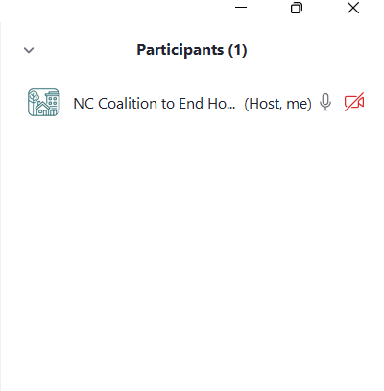


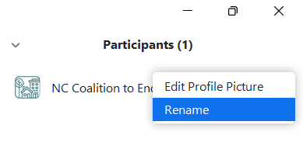
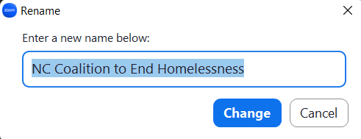
Attendance
1
Please enter your name & agency in the chat so we know who is here today!
How to change your screen name:
2

Slide 3

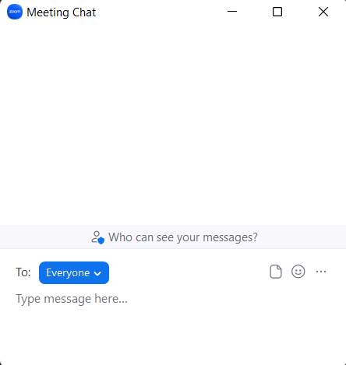
Welcome
  We will be recording today’s webinar and sharing it on our website for future reference. If you have a question, please raise your hand or place your question in the chat, and questions will be addressed cohesively with the presentation.
  Please keep your line on mute except for when you are asking a question.

Slide 4
Agenda

Slide 5
Agenda
What we can expect in the FY2026 CoC Program Competition
Implementing new NC BoS CoC Written Standards
Changes to Local Competition Process
Updates to FY2026 Grantee Agreements
Next Steps

Slide 6
FY2026 CoC Program Competition:
What We Can Expect

Slide 7
Thinking Back to December 2025 NOFO
On December 19, 2025, HUD released a FY2025 NOFO that attempted to supersede the 2-year NOFO. This NOFO included the current administration’s funding priorities and established new criteria for applicants.
Major changes included:
Reduction in Tier 1 funding (30% of ARD)
Funding cap for permanent housing (30% of total request)
Set aside for new PH projects serving people with disabilities (Transition Grants)
Ending support for Housing First and certain race/gender equity practices
Required client participation in supportive services
Prioritizing projects that provide/partner with substance use treatment

Slide 8
How Our CoC Responded
Our Funding and Performance Subcommittee created new CoC Program Funding Priorities that adopted language from the NOFO, created an equal priority level for RRH and PSH, and encouraged applications for TH and SSO project types.
Our Scorecard Committee created new scorecards that awarded points to applicants based on HUD’s threshold and “project quality” criteria.
Our Steering Committee approved new Written Standards that created standards for TH and SSO and made several changes to the other project types: see Written Standard Change Document.

Slide 9
Impact of Court Rulings
Court ruling against the December 2025 NOFO stopped HUD from implementing this new competition and required them to “auto-renew” existing grants.
Court ruling against CoC Builds NOFO determined certain new criteria (point reduction for harm reduction, applicant’s local laws, policies for protecting transgender persons) to be unlawful.
These outcomes will not explicitly prevent HUD from releasing the same December 2025 NOFO for the FY2026 Competition. We can expect very few changes in terms of funding priorities and applicant criteria.

Slide 10
What We Know About FY2026
FY2026 spending bill passed by Congress requires HUD to release the FY2026 NOFO no later than June 1, 2026 and to award funding to applicants no later than December 1, 2026
Tier 1 must be set at 60% of ARD or higher
  No further information on permanent housing funding cap
The HUD Reform Act requires that HUD must provide all information about a funding opportunity at least 30 days before the deadline
  60 days is typical, but 30 days is the minimum without an emergency waiver
  According to grants.gov, the FY2026 NOFO is estimated to be released on May 29 and to have a final due date of August 26.

Slide 11
What We Can Expect About FY2026
TH and SSO will be newly eligible project types
Same threshold requirements = same/similar scorecard
Funding cap on permanent housing projects
Service participation requirement (40 hours/week for TH*)
Prioritizing projects that provide or partner with substance abuse treatment
Prioritizing specific outcomes: income growth, positive exits
Prioritizing collaboration with law enforcement (SSO) and other public and private resources (Medicare, Medicaid, SNAP, SSI)
Collaborative Applicant Scoring
  CoC Board includes elected public officials, representative from business community, representatives from law enforcement
  Substance use treatment available on-site for 30% of projects
  30% of CoC’s total funding request is for supportive services
  Reduction of people residing in encampments by 20%
  “Protecting Public Safety”- clearing encampments, criminalizing homelessness

Slide 12
Reacting to a PH Funding Cap
While no information has come out about a PH funding cap in the FY2026 Competition, we can expect to see it again.
To create a collaborative action plan as much as possible, NCCEH will ask renewal applicants about their agency’s application intentions in response to the funding cap in the Intent to Renew process. Information about whether you plan to reduce or reallocate your project, and whether you intend to apply for a new TH or SSO-SO project, will be shared with other grantees to help inform their decision-making. Utilize the FY2026 scorecard to help inform your decision. Applicants will not be held to what they propose in the Intent to Renew form.
Without this collaborative action and if all existing grantees apply for a full renewal, our CoC is likely to lose complete PH projects, reducing the PH coverage across the state and across subpopulations.
What else would help inform your decisions? How else can we work together on this plan?

Slide 13
Current NC BoS CoC Funding
The following information is from the FY2025 Grant Inventory Worksheet and includes CoC projects funded by the FY2022 Special NOFO. In FY2025, the proposed permanent housing (RRH + PSH) funding cap was 30% of our total request (ARD + new projects created through Bonuses).
Regular CoC RRH | $4,464,013
SNOFO RRH | $4,706,176
Regular CoC PSH | $9,853,473
SNOFO PSH | $2,219,600
SNOFO SSO | $1,302,724
HMIS | $812,069
Coordinated Entry | $447,753
Total (FY2025 Annual Renewal Demand) | $23,805,808
Percentage of ARD that was PH in FY2025 | 89.2%

Slide 14
Implementing New Written Standards

Slide 15
New Written Standards
At the beginning of December, our Steering Committee (now Governance Board) approved a new set of Written Standards for CoC and ESG funded projects. While we ended up not having to transition over to these standards due to the 2-year NOFO “auto-renewal”, we can expect to move to a new version of Written Standards in FY2026.
After a recent meeting with HUD TA, we understand that even the FY2025 version of our Written Standards may not be sufficient in terms of capturing changes in HUD’s priorities for the FY2026 competition. At this time, it is the advice of our HUD TA to remove our Client Bill of Rights and Anti-Discrimination policy from the NCCEH website, and potentially even our Written Standards.
NCCEH is preparing to quickly update our Written Standards for FY2026 as soon as we have the information from HUD that we need about what is required and what is prohibited (NOFO). All CoC grantees will be expected to have these new FY2026 Written Standards reflected in their project’s policies and procedures. They do not need to implemented until the start of your FY2026 award’s operating year and we will not review them as a part of the FY2026 Competition.

Slide 16
Reviewing P&P in Competition
The Scorecard Committee will be asked to consider moving Written Standards review off of the scorecard (meaning, out of the competition) and to a monitoring process, giving grantees more time to implement the FY2026 Written Standards. But since your project’s policies and procedures are potentially subject to review by HUD, you can start now by making sure your P&P includes/excludes the standards that are potential “flags” to HUD. NCCEH is confident these will be a part of the FY2026 Written Standards.
“Flags” to remove:
Following the Housing First model
Implementation of harm reduction activities
Any policies that may interpreted as racial or religious preferences or targeting service to specific subpopulations, like LBGTQ+ persons
References to gender identity (as opposed to sex)
Optional participation in supportive services
Client Bill of Rights and Anti-Discrimination Policy
*References to participants
Key components to Include are
Utilizing a “Low Barrier” approach instead of Housing First
Mandatory participation in supportive services and client-specific participation agreements

Slide 17
Changes to FY2026 Local Competition Process

Slide 18
CoC Program Competition Redesigned
Each CoC’s Collaborative Applicant, as part of its CoC Planning Activities, must design, operate, and follow a collaborative process for the development of applications and approve the submission of applications in response to a NOFO published by HUD.
Natalie Rivera – CoC Program Portfolio Specialist - NC BoS CoC staff team position designated for all things CoC Program related in the NC BoS CoC
Update and Simplify FY2026 CoC Program Funding Priorities
  NC BoS CoC Staff to review and send draft to FPS for feedback
  Review & approve edits and feedback at May 21st FPS meeting
  Governing Board approval of Funding Priorities – June 2nd
Using ZoomGrants – to reduce issue with missing documents, reduced number of questions
  Mandatory Intent to Apply/Intent to Renew process through Smartsheet

Slide 19
CoC Program Competition Redesigned
Revise the competition to reduce the administrative burden of applicants and reviewers – in terms of required documents
  Consider what can be shifted to our in-development monitoring process
  Eliminate Supplemental Information Form
  Certifications of Consistency with Consolidated Plan – aiming to use one summary sheet of all projects to send to the state’s Department of Commerce electronically
Implement a Project Threshold Review – one pager (“go or no-go”) conducted by NCCEH staff to reduce the content on the Scorecard reviewed by the Project Review Committee. Content will be objective standards pulled from what’s currently on the Scorecard- eligible applicant; eligible project type; adherence to CE; BoS CoC membership & in compliance
Scorecard
  Build in Excel for auto-calculating scores
  Scorecard Committee – meet in May/Governing Board approval of Scorecard – June 2nd
Provide office hour support for applicants

Slide 20
CoC Program Competition - Reminder
The application content you submit in ZoomGrants by the local deadline, including your official project application downloaded from e-snaps, is what will be reviewed by the Project Review Committee. Reminder that there are standards related to application completeness, accuracy, and timeliness already built into the Scorecard. While NCCEH cannot give specific program-level advice to remain impartial during competition season, we can help interpret what a question is asking for or provide technical assistance.
Reminder that NCCEH has a Project Review Form to provide you with feedback on how to improve your project application, in terms of accuracy and completeness, before submission in e-snaps. We will be unable to provide additional review or feedback.

Slide 21
Updated Grantee Agreement

Slide 22
FY2026 Additions
Additions were made to the FY2026 CoC Grantee Agreement to provide better clarity on expectations. Many of these are already being completed or adhered to by CoC grantees.
Instead of listing required data elements to be collected in HMIS, we ask that agencies agree to the HMIS Participation Agreement, Data Quality Plan, Operating Policies and Procedures, and User Agreement/Code of Ethics. If your project is in HMIS, you have already agreed to these policies.
Updated point about following NC BoS CoC Written Standards to include the NC BoS CoC Client Bill of Rights.
Projects should follow the organization’s financial policies that are in line with 2 CFR Part 200, as required, and will include a procurement policy.
It is the responsibility of all CoC Program-funded service providers to notify NCCEH within 24 to 48 hours of any significant disruption to service delivery.
Grant recipients will use ZoomGrants moving forward to upload quarterly APRs and bi-annual eLOCCS spending report screenshots to share with NCCEH.

Slide 23
Next Steps

Slide 24
Next Steps
Stay tuned for additional announcements about FY2025 Q3-Q4 awards
Stay tuned for pre-competition GIW review
Confirm your agency is registered in SAM and you have your UEI number
Ensure you can login to e-snaps and review your Applicant Profile for accuracy. Ensure your agency has an up-to-date Code of Conduct on file with HUD (also attached in Applicant Profile)
Determine if your project operates in a local jurisdiction that requires a HUD 2991 Form – Certification of Consistency with the Local Consolidated Plan
Think ahead about required permanent housing funding reductions, supportive service requirements, and potential shifts to SSO or TH
Stay vigilant about the local competition timeline once released
Brush up on ZoomGrants and ensure you have an active account

Slide 25
Questions?
Reach out to Natalie Rivera:
919-410-8598
natalie.rivera@ncceh.org

