Slide 1
Before we get started
Steps to get started
Download the Counting Us App
Register (or use Forgot Password)
Log In
Select “Choose Count”
Join the Count with Key: “ncbos2024”
Select your Region based on County
Click “Get Started”
If you have used Counting Us before, you must still select Choose Count for this year!
Notes:
Ask folks to wait until the end to try to log into the App. It will be helpful to see the flow in it’s entirety!

Slide 2
2024 Point-In-Time Training for non-HMIS Agencies

Slide 3
We want to get to know you!
Sign in by checking your name (full names help us with follow-up)
Ask questions and share how many PIT Counts you’ve participated in
OR

Slide 4
Slides & resources will be available!
We’re covering brand new material today!
We'll post these slides and companion resources on the website. https://www.ncceh.org/bos/pithic/
This information will be good to share with your team, so everyone is starting from the same place.

Slide 5
Agenda
Introduction
Inside the Counting Us App
Frequently Asked Questions
Best Practices
Timeline & Follow-up

Slide 6
Introducing the PIT/HIC

Slide 7
Point in Time and Housing Inventory Count
Contribute to Regional Counts!
Advocate with stakeholders!
Helps fund resources!
It’s required!

Slide 8
Point in Time and Housing Inventory Count
January 31, 2024
People
Beds and Units
How many people are experiencing homelessness?
How much capacity does our system have?
Notes:
What capacity do we have to provide temporary shelter in emergency shelters and transitional housing?
What capacity do we have to provide housing in rapid rehousing, permanent supportive housing, and other permanent housing projects?

Slide 9
Data Collection for Point-in-Time Count
Unsheltered | Sheltered Count
 | HMIS ES + TH | Non-HMIS ES + TH
By Name List Reports | HMIS Reports | Counting Us App
Verification of current status: Feb 1 – 7 | Work with NCCEH Data Center to finalize data and submit reports | Data submitted Feb 1 – 7

Slide 10
Data Collection for Housing Inventory Count
Temporary Sheltered |  | Permanent Housing
HMIS ES + TH | Non-HMIS ES + TH | HMIS RRH + PSH + OPH | Non-HMIS RRH + PSH + OPH
HMIS Reports: Work with NCCEH Data Center to finalize data and submit reports | People Count: Counting Us Survey App (Due 2/7) | HMIS Reports: Work with NCCEH Data Center to finalize data and submit reports | People Count: Counting Us Survey App (Due 2/7)
 | Bed + Unit survey with NCCEH staff (Due 2/21) |  | Bed + Unit survey with NCCEH staff (Due 2/21)
Notes:
Survey can be scheduled in January as we approach PIT night! HIC focuses on program details about capacity with number of beds/spots, rooms, federal funding sources, and dedicated beds for certain populations. This is also where we’ll ask you about the when beds are available – all year or only sometimes?

Slide 11
Today’s Focus
…is the Sheltered Count for Emergency Shelters, Transitional Housing, Rapid Re-Housing, and Permanent Supportive Housing projects who do not participate in HMIS
Questions about Unsheltered and HMIS data collection?
Unsheltered: Go to your Regional Unsheltered Access Coordinator or CE Lead for local information (listed for each region/county on ncceh.org/bos/pithic)
HMIS: Contact the Data Center at hmis@ncceh.org

Slide 12
Introducing the Counting Us App

Slide 13
Why Use the Counting Us App
Accurate
Logical
Easy
Fast
Secure
Notes:
Accurate
Helps make sure everyone’s experience is counted by age, race, ethnicity, gender, county, disability
Geography and demographics can be cross-tabulated
Helps de-duplicate folks
Logical question layout
Only applicable questions
Kids aren’t asked if they’re Veterans
You don’t have to know the chronic homeless definition, automatic
Connect household members together
Easy
Works on phones, tablets, and computers connected to internet
Simple login, simple to reset passwords
Save results and submit later for bad cell coverage areas
Fast
Sends in real-time
Reduces delay of both paper forms and back and forth questions
Secure
All data transmitted to and from the command center is protected using RSA 2048-bit encryption
Access to the data is limited to CoC staff
Encryption is “Advanced Encryption Standard AES-256”

Slide 14
Additional Security Procedures for VSPs
Project Location:
A location is required (at least accurate for the County)
If there are concerns, we can pre-load a nearby location of your choosing
Option, use the address of your county’s DSS
Chat here or write your NCCEH contact to let us know
Client Names:
Initials are needed
Partial/Full names are encouraged to support de-duplication
Notes:
Victim Service Providers (VSPs) are defined by HUD as a private nonprofit organization whose primary mission is to provide direct services to survivors and victims of domestic violence, dating violence, sexual assault, stalking, or human trafficking. VSPs do not participate in HMIS due to a federal VAWA Act prohibition.

Slide 15
A look inside the App
Steps to get started
Download the App
Register (or use Forgot Password)
Log In
Select “Choose Count”
Join the Count with Key: “ncbos2024”
Select your Region based on County
Click “Get Started”
If you have used Counting Us before, you must still select Choose Count!
Notes:
Ask folks to wait until the end to try to log into the App. It will be helpful to see the flow in it’s entirety!

Slide 16
Use the Sheltered Survey to make sure your clients count!
Emergency Shelters and Transitional Housing projects:
Add surveys for everyone sleeping under your roof (physical building or the hotel/motel you paid for) on PIT night
Rapid Re-Housing, Permanent Supportive Housing, or Other Permanent Housing projects:
Add surveys for everyone sleeping in a permanent housing unit on PIT night (and still enrolled)
Notes:
Everyone who is submitting data through the app will use the “Sheltered Survey”

Slide 17
Demo
Let’s dive in
Notes:
Then a anew last reminders

Slide 18
Add your location
Add the location of this conversation
Use your device’s location OR
Use an address or intersection
For facility-based shelters, an address can be saved by your NCCEH contact so you can skip this step!

Slide 19
“Have you already been interviewed today for the point in Time Count?”
This question has been removed!
In past years, there has been a survey question for clients to see if they have answered the PIT this year
It was sometimes hard to know if the right answer was Yes or No
So, it’s been removed!

Slide 20
Sub-population
The next few questions relate to Disabling Conditions
Self-reported by clients
No documentation needed
Please ask the follow-up questions

Slide 21
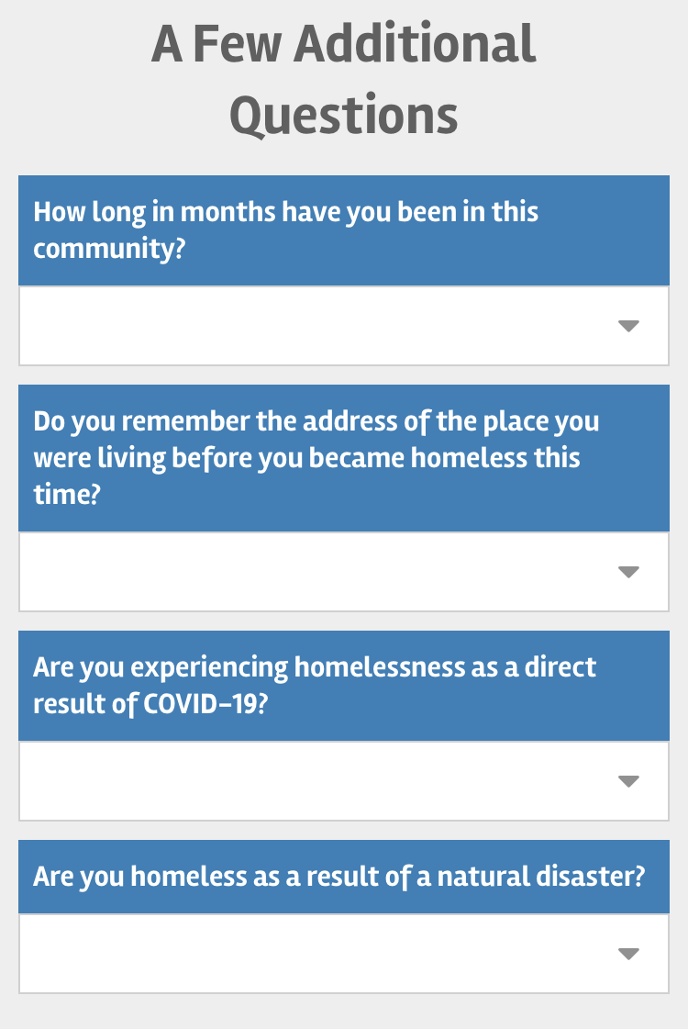
Optional
You can skip these

Slide 22
Submitting the survey
Submissions are per person
If you are out of cell-service or don’t have data, use Save Draft
Review drafts from the home page
Open the draft and submit it individually
Make sure you remember to submit all your drafts by February 7th
Notes are only read by NCCEH staff and cannot connect people to services

Slide 23
Now let’s see the screen for a household
Start with the correct Survey Activity
Select Sheltered
Select Household and the number of total clients in the family (however they present!)
Individual surveys cannot be reconnected later
Notes:
Step back and remind folks that this is the a critical decision when using the app.

Slide 24
Best Practices
Conduct client interviews with App questions
Promotes consistency across the whole region and country
App includes different questions than intake
Information may have changed since your intake
Conduct night of or morning after PIT night
Easier to know who to count
Avoids double counting
Plan a designated time – perhaps integrate into existing scheduling
Survey individuals in private spaces whenever possible
Answering the PIT survey is not required to receive services

Slide 25
Tips for Good Etiquette During PIT:
General tips:
Explain the purpose of the annual one-night homeless census of people experiencing homelessness.
Use open-ended questions when asking demographic questions:
“What is your gender?” or
“What is your race?” or even add,
“of these options…"
It’s ok to refuse questions! It’s up to us to ask them.
Remember you are asking for someone’s time. Thank folks for their help.
Offering socks, hygiene products, or gift cards may help incentivize participation.
Notes:
General tips apply to all PIT volunteers
All of the listed questions must be asked of all persons being surveyed and it is completely voluntary whether persons respond to questions. We have limited the survey to just the question we really need for reporting to the community and HUD.

Slide 26
Frequently Asked Questions
Learn from the experts!
Confirm if the survey is for an Individual or Multiple Member Household before beginning
Demographics (race, gender) are check all-that-apply questions
Confirm your project’s address with your BoS Contact ahead of time to avoid typing in the address
Ask the disability questions – this helps identify folks experiencing chronic homelessness
In past years, there’s been a pre-screen question “Has someone asked you about the point in time”. That has been removed!

Slide 27
Next Steps to a non-HMIS Sheltered PIT/HIC
Prep
December – January 30th
- Practice with the Counting Us App
Survey
January 31st – February 7th
- Conduct PIT App surveys of clients
Follow-up
February 1st -21st
- Review PIT data and participate in HIC interview with NCCEH staff
- Confirm your NCCEH staff contact
- Check that all surveys submitted
- Alert your NCCEH contact
- Respond to any follow-up questions
Key to success: Schedule your follow-up ahead of PIT!
Notes:
Let your contact know if you have questions about the App ahead of time, let your contact know when all surveys are done, and completing your HIC survey for program information close to Jan 31st will help all!

Slide 28
Upcoming events to help you prepare!
Friday, January 6th
Small-group, real-time app practice sessions
10am – 11 AM https://us06web.zoom.us/j/83559758612 Meeting ID: 835 5975 8612 | 2 – 3 PM https://us06web.zoom.us/j/82577634395 Meeting ID: 825 7763 4395
Wednesday, January 11th This training is VSP (Victim Service Provider) specifically
10am – 11 AM ​ https://us06web.zoom.us/j/83559758612 ​ Meeting ID: 835 5975 8612​
Friday, January 13th
Small-group, real-time app practice sessions
10am – 11 AM ​ https://us06web.zoom.us/j/83559758612 ​ Meeting ID: 835 5975 8612​ | 2 – 3 PM ​ https://us06web.zoom.us/j/82577634395 ​ Meeting ID: 825 7763 4395​
Notes:
Make sure to check which link you’re using – different in the afternoon and morning sessions. January 11th also has 9:30 -10 sign in support

Slide 29
Now you try!

Slide 30
Help us test the App!
Login now to practice!
Please submit at least 1 individual or household surveys
Try out different fake clients
Make sure your projects are accurate!
Test mode will be active until Jan 24th
Send questions and feedback at bos@ncceh.org
Notes:
Currently, the sheltered count isn’t ready for testing but we’ll be building that out for testing soon! We’d love to have non-HMIS participating agencies use the app to collect information from clients this year.
Once you’ve logged in, select your Region!

Slide 31
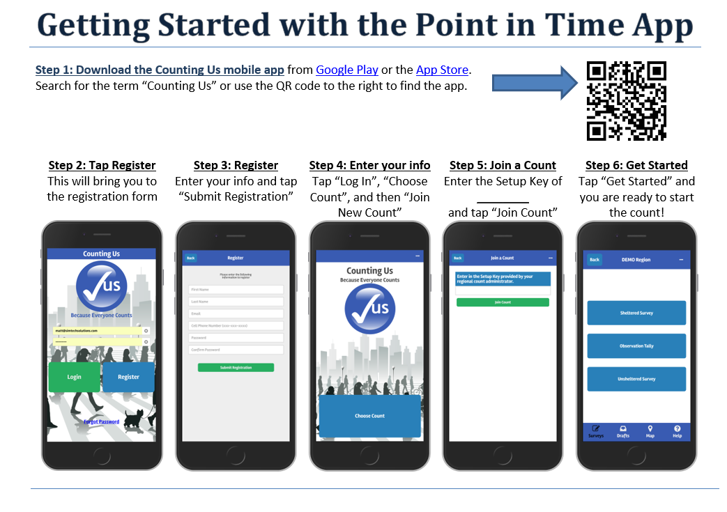
ncbos2024

Slide 32
ncbos2024

Slide 33
Stay Connected
https://www.ncceh.org/bos/pithic/
This page on the NCCEH website is the go-to place to
find regular updates, trainings, and
other important information.

