Slide 1
Racial Equity Subcommittee Meeting
NC Balance of State CoC
February 16, 2022 at 11:30 AM
The purpose of the Racial Equity subcommittee is to identify areas in NC Balance of State CoC’s policies that may contribute to racial disparities in access to and services from the homeless system and to recommend changes to them.

Slide 2
Logistics
Notes:
Laurel

Slide 3
Welcome
Your line is not muted.
Please mute yourself.
The chat box is available to use anytime.
Notes:
Everyone is currently on mute. We encourage your questions though.
We want to encourage the use of the chat box. We will monitor the chat box for activity and make sure we respond to your questions.

Slide 4
Camera
To foster connection, we encourage every member to turn on their camera. The camera graphic is at the bottom of your screen.
We have a lot of people! It may be easier to set the cameras to only show who is currently speaking. You can access this setting at the top of the screen.

Slide 5
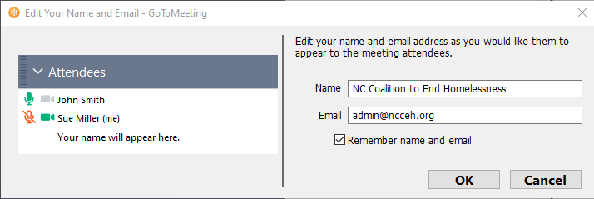
Attendance
1
Participants should right click on the caller marked as ‘me’ and fill in their full name and email address.
Please enable your webcam (if possible). Let's get to know each other as much as possible!
2
Notes:
Please be sure to enter your full name and email address in the tool bar, if your name is not already there. We will use the email addresses collected here to send information out about the CoC competition.
* Roll Call*

Slide 6
Agenda

Slide 7
Agenda
Celebrations
2022 Goals!
Announcements
Share your successes in the chat box!
Introductions
Updates
Notes:
Change as needed

Slide 8
Subcommittee process and listserv

Slide 9
Intention is for more participation in 2022
Culture of these meetings has been a lot of staff talking and updates
More conversation to come next month.
Inclusion of invitation for announcements and agenda items at the end of each meeting.
Notes:
Bring up the racial equity network listserv

Slide 10
Workgroups

Slide 11
Workgroups: Equity Initiative Core Team
*Formerly known as the Prioritization Workgroup
NC Balance of State CoC was selected to participate in HUD’s second cohort Equity Initiative Technical Assistance. We get community coaching with experts for the next 9-12 months. Just 8 other communities were chosen!
Goal: to create a replacement CE Prioritization Tool to the VI-SPDAT!
Our Core Team is recruiting!
RE Members (so far!): Angela, Deniece, Jeff, Lori, Teresa
Staff: Allie, Andrea, Ashley, Brian
Email andrea@ncceh.org to learn more about joining the workgroup!
Notes:
NCCEH staff are also participating: Andrea, Ashley, Allie, and Brian

Slide 12
Workgroups: Racial Equity Dialogue Series
Last Year
•Continued important conversations on systemic racism and its impact on homelessness, and services for people experiencing homelessness.
•2 event series held in Oct and Nov, 2021
•Over 70 people in attendance at both events
Workgroup first meeting 1/7/22 Workgroup meetings schedule TBD. Topics will be presented in February RE Subcommittee Meeting
Goal Dates for 2022
April 12
June 21
October 18
CALL TO ACTION!
Email sarah@ncceh.org to learn more and join the workgroup!

Slide 13
Goals for 2022
Notes:
Goal Setting: Introduce the tool Jamboard, (stickies, panels, then Identify what rises to the top, main subcommittee vs workgroup) - RE Assessment - Equity Initiative to improve CE - Dialogues - Scorecard (Eval & Dev)
All one color b/c from last year - green sticky anti-discrimination possibility Invite more Stickies for ideas - give 5 min? Breakout into smartsheet categories for r - Governance - Data - Education

Slide 14
Celebrations and Announcements
Notes:
Sarah

Slide 15
Agenda items for next meeting?
What needs to be discussed?

Slide 16
Wrap Up
Next Meeting:
Keep in touch
bos@ncceh.org
919.755.4393
March 16th
11:30 A.M.

