Slide 1
SOAR Dialogue Call June 2026
Natasha Posey, NC SOAR State Lead

Slide 2
SOAR Updates
Durham SSA FO Update:
Ritu Chowdhurry is joining Shelby Rittman to assist in processing SOAR claims – woohoo! Shelby sent an informative email out to providers regarding processing changes. Let me know if you need it forwarded to you.
DDS Update:
An updated SOAR DDS Examiner List has been uploaded to the NC SOAR Shared Drive
SORT went live May 28th!!! Register and submit your outcomes!!!
Our next SOAR Plus! Training will be held in September – registration info will be available on our website at ncceh.org in August.
New SOAR Providers – please join a local SOAR Workgroup for peer-to-peer support and learning

Slide 3
NCCEH Announcement
This month, NCCEH will be offering a free virtual workshop on the fourth Thursday of each month from 2-3 PM
June 25th: HR for NonProfits
Who should attend:
Service providers, local government employees, elected officials, funders, concerned citizens -- anyone who wants to get a better understanding of how and why CoCs function the way they do, and how to optimize your CoC's efforts to achieve lasting housing solutions for those experiencing homelessness
Click here to register!
For questions: liz.carbone@ncceh.org

Slide 4
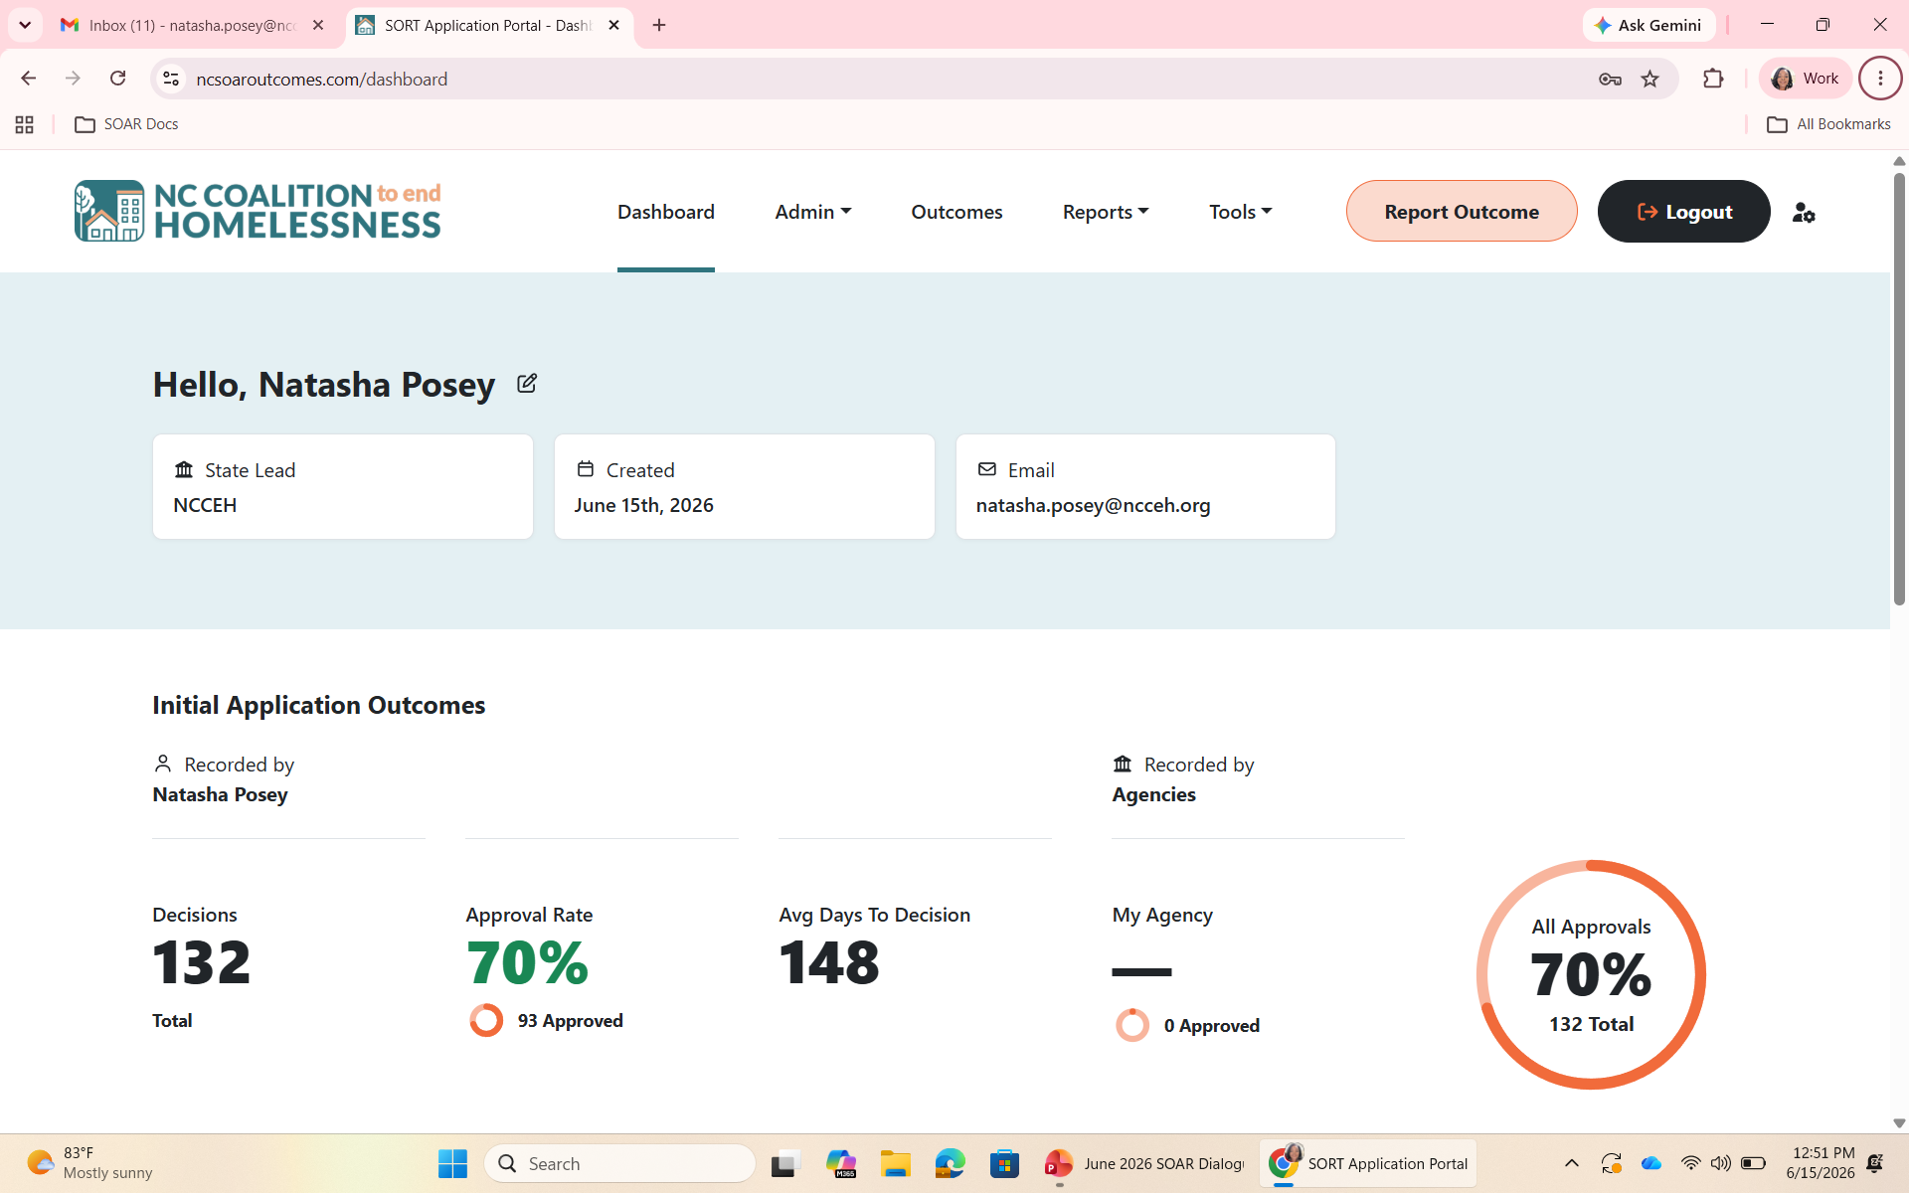
SORT Review

Slide 5
Time for Q&A, Reflections, Advice
The floor is open for you all to share!
Our next meeting will be held February 17th at 10 am and we will overview an SSA Blue Book Listing

